Slide 1
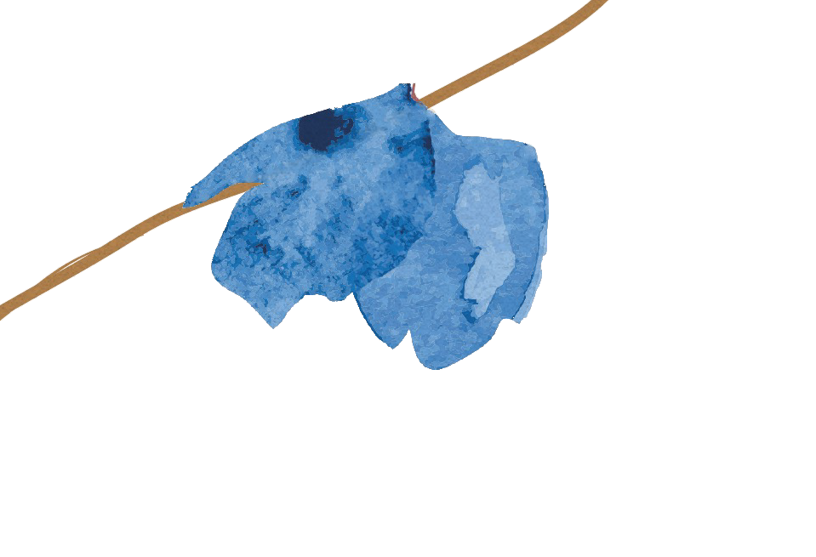
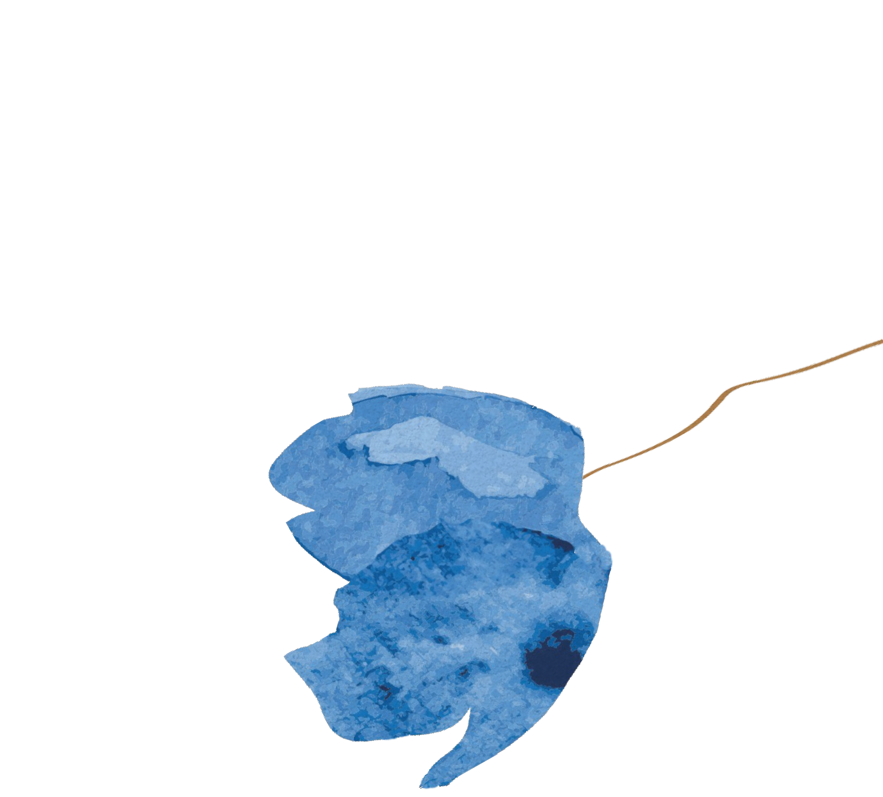
Emotional Inheritance
Moving beyond the legacy of trauma
Galit Atlas, PhD

Slide 2
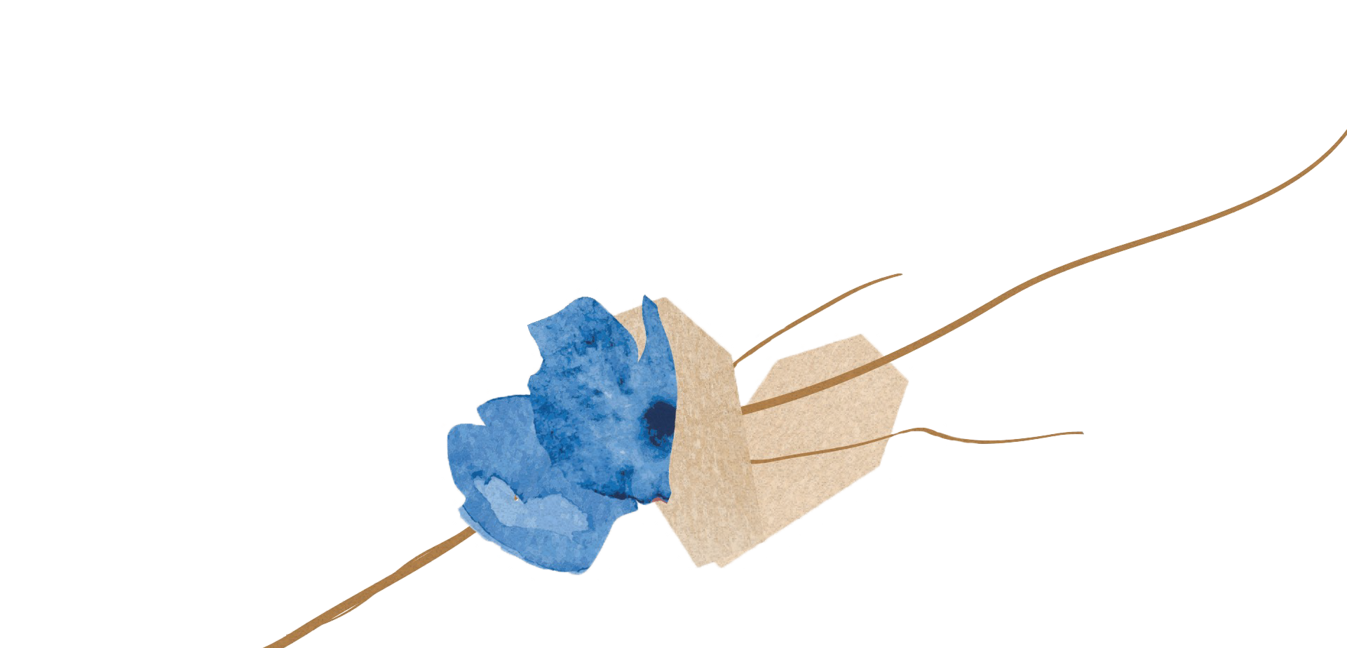
Every family carries some history of trauma. Every
trauma is held within a family
in a unique way and leaves its emotional mark on those who are yet to be born.

Slide 3
The Radioactivity of Trauma:
Repressed secrets become nameless dread. They live in our psyche, like radiation, with no form, color, or smell.

Slide 4
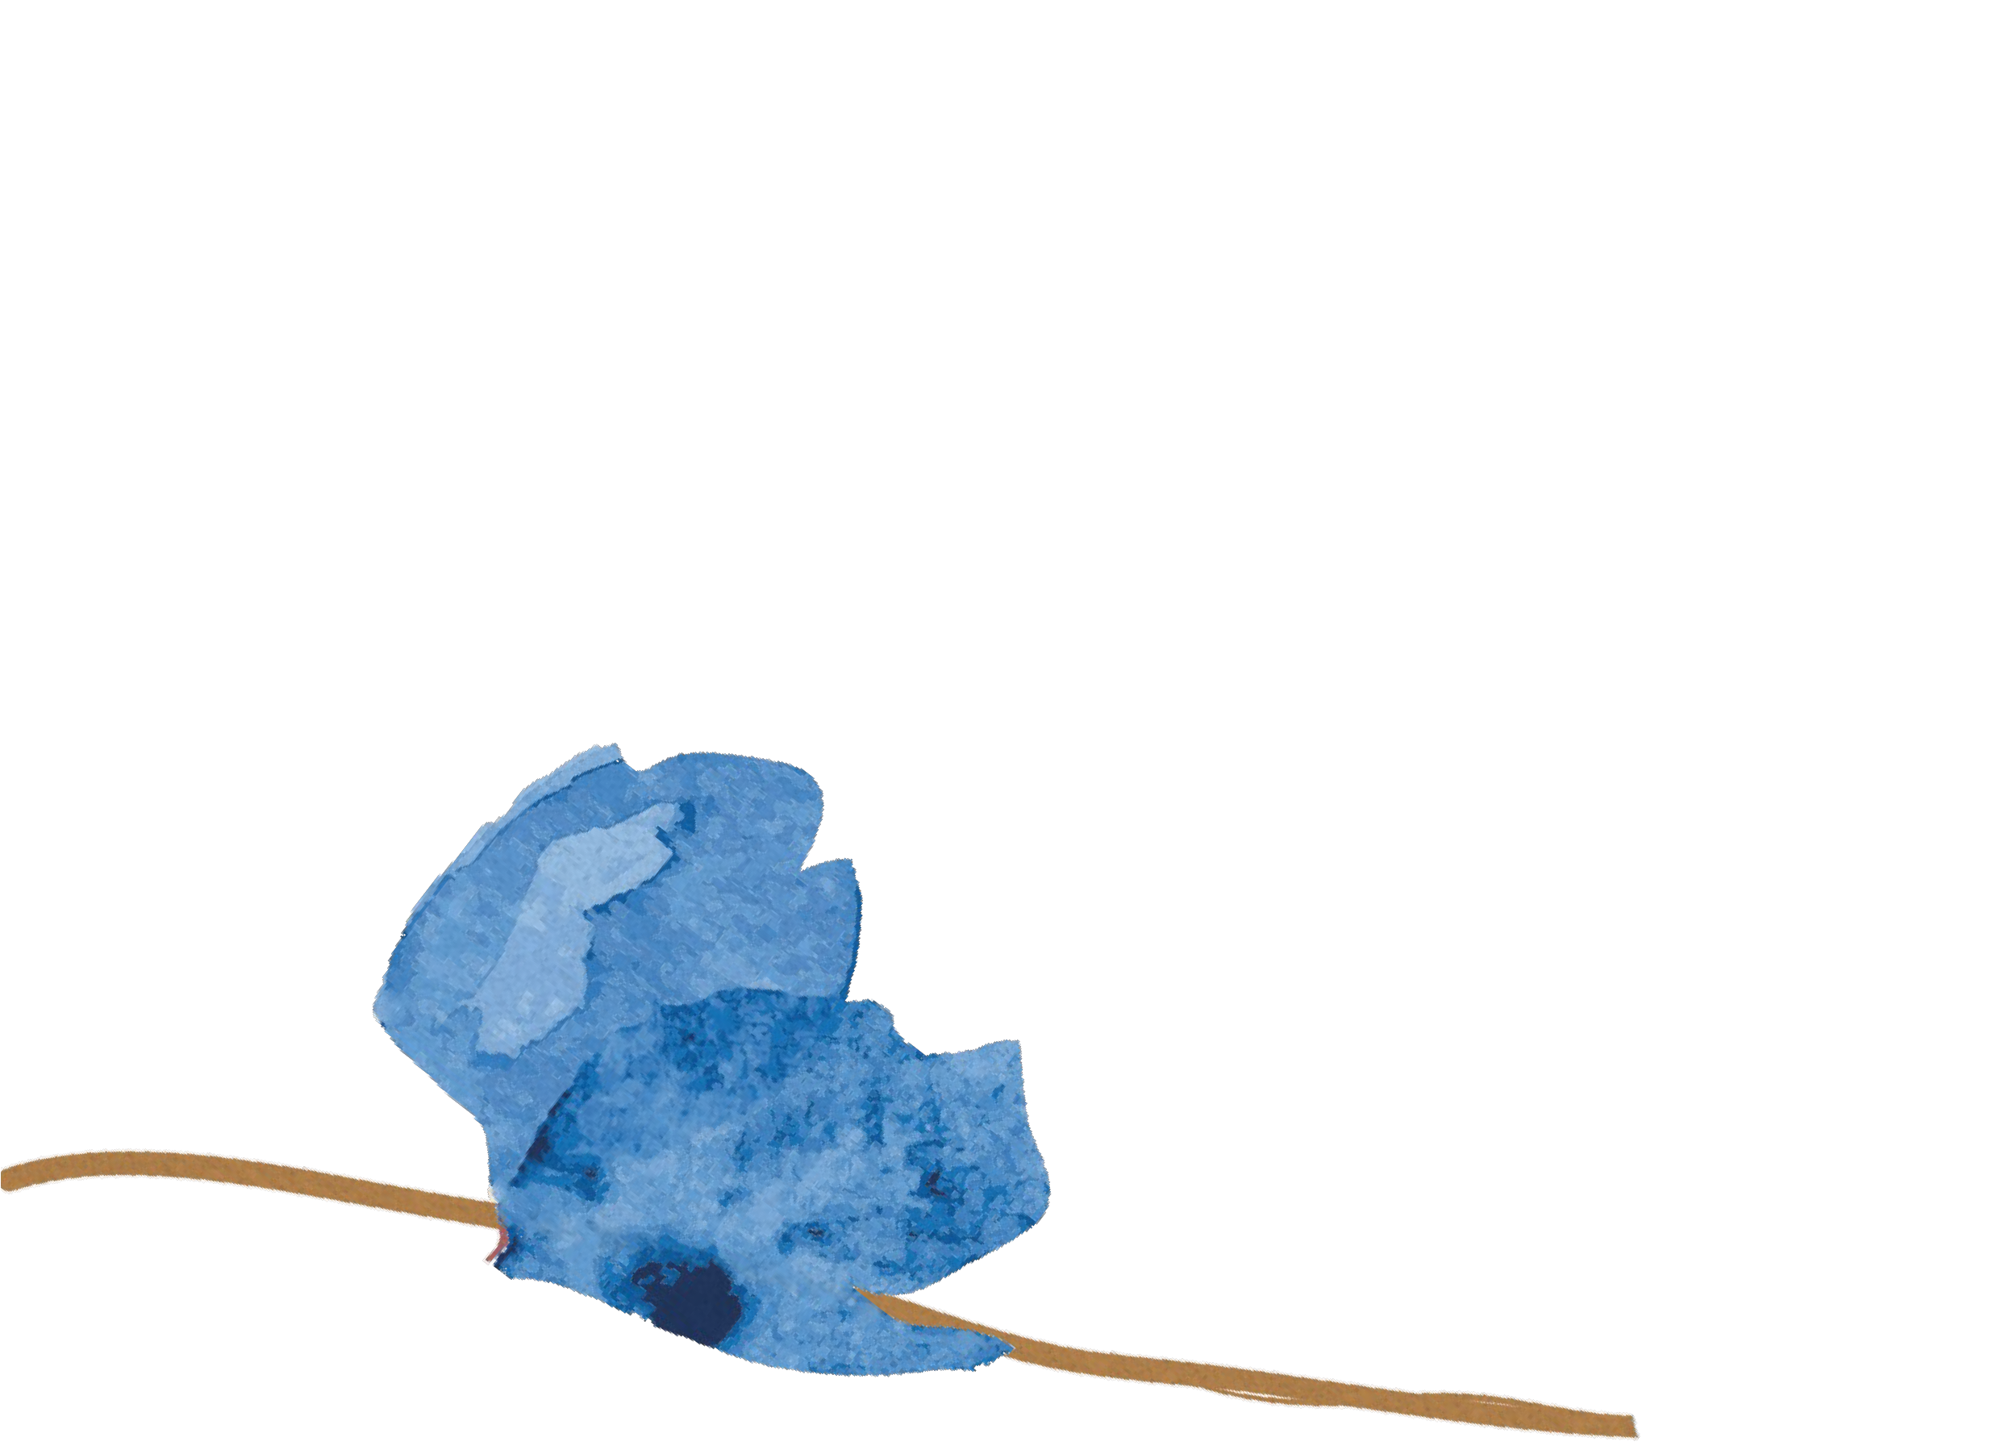
“Traumatic events leave us stuck in a state of helplessness and terror, and result in a change in how we perceive danger.” (van der Kolk)
How does it impact the next generation?

Slide 5
The people we love and those who raised us live inside us; we experience their emotional pain, we dream their memories, we know what was not explicitly conveyed to us, and these things shape our lives in ways that we don’t always understand.

Slide 6
We inherit family traumas that we
weren’t told about.

Slide 7
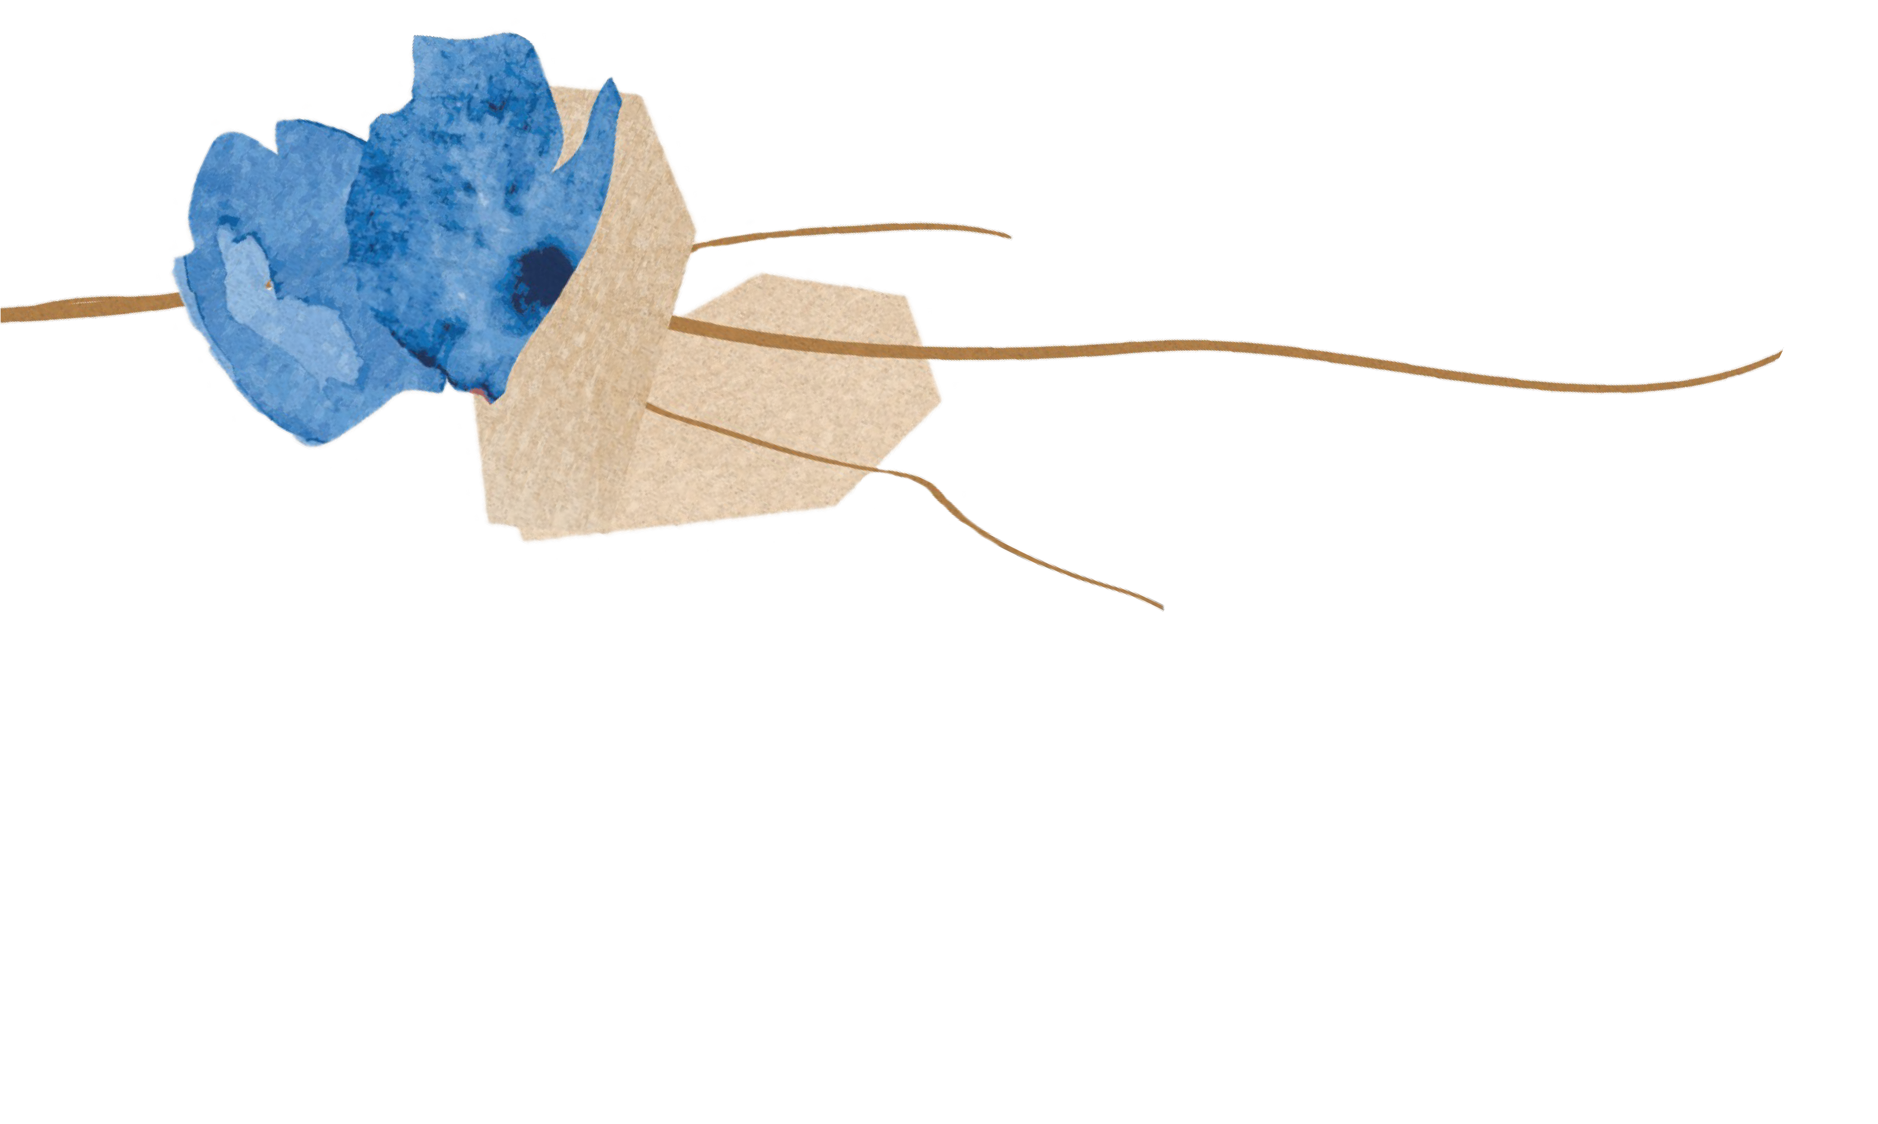
“What haunts are not the dead,
but the gaps left within us by
the secrets of others.”
(Torok and Abraham, 1978)

Slide 8
The ghosts of the unsaid and the unspeakable live in our unconscious.

Slide 9
Epigenetics:
The ways in which the environment, and especially trauma, can leave a chemical mark on a person’s genes that is passed down to the next generation.

Slide 10
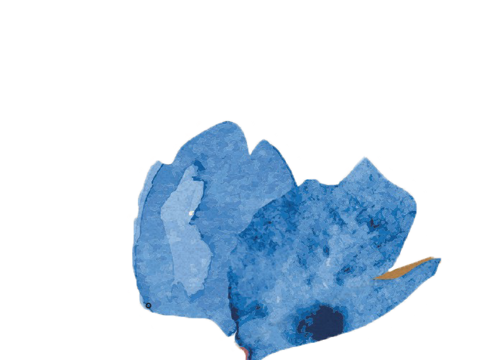
As children we are tuned in to our attachment figures, to the people we are dependent on. We register not only what they say, but also, and especially, what they don’t say. We monitor their physical gestures, facial expressions, moods, and rhythms.

Slide 11
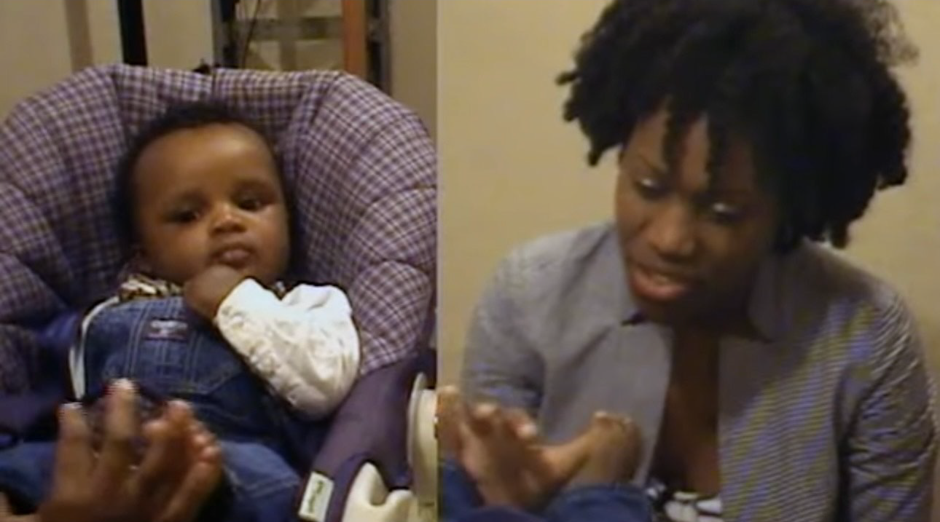
(Beatrice Beebe)

Slide 12
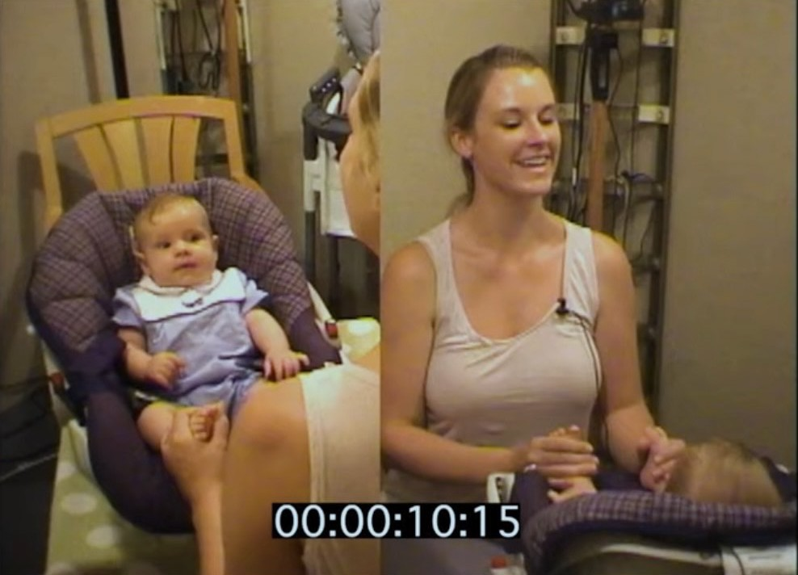
(Beatrice Beebe)

Slide 13
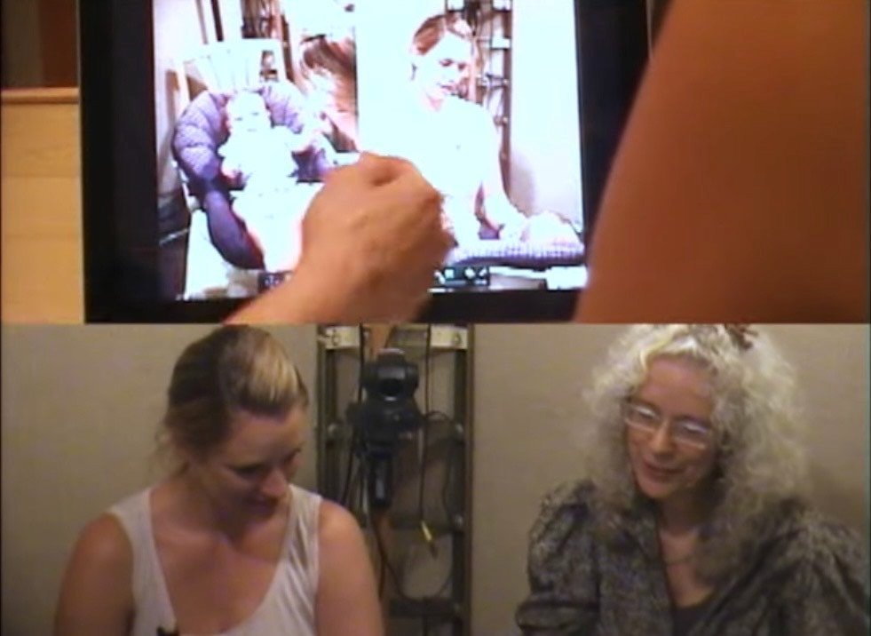
(Beatrice Beebe)

Slide 14
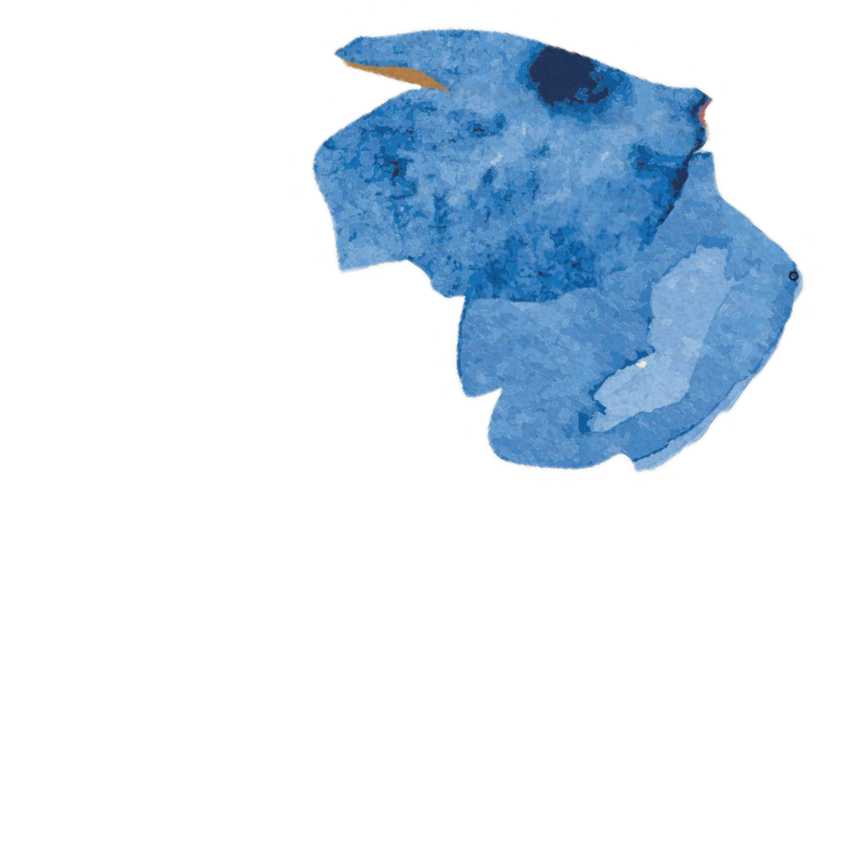
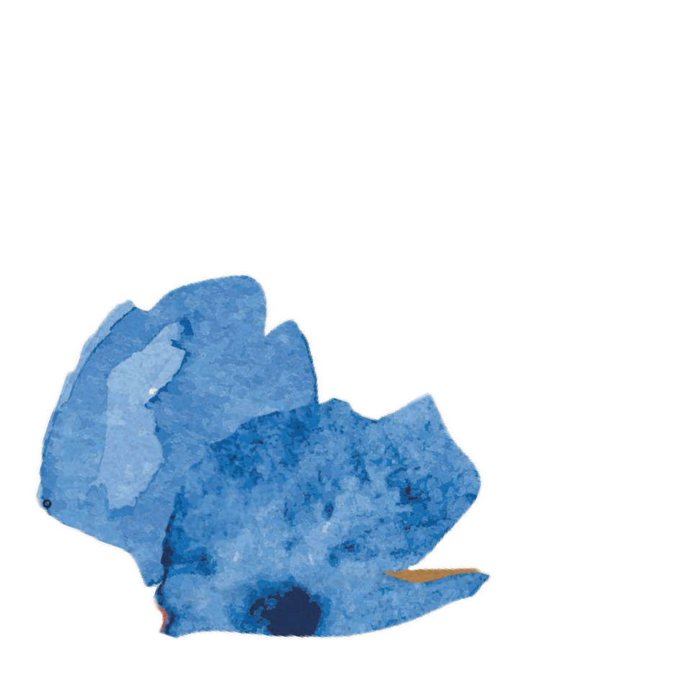
Infant research on parent- infant interaction shows us that babies respond to their parents’ implicit signals from the moment they are born.

Slide 15
Like detectives, we follow the signs and listen not only to
what is said but also to the pauses, listening to the omissions, to stories untold.

Slide 16
Names contain the memory of the past as well as the visions of the future.

Slide 17
Empty Cycle:
“ The absence of representation, the
rupture of the self, the erasure of memory, and the accompanying sense
massive psychic trauma.”
(Laub, 1998)
of void that are the core legacy of
Emotional

Slide 18
Healing is a journey
filled with ambivalence and guilt.

Slide 19
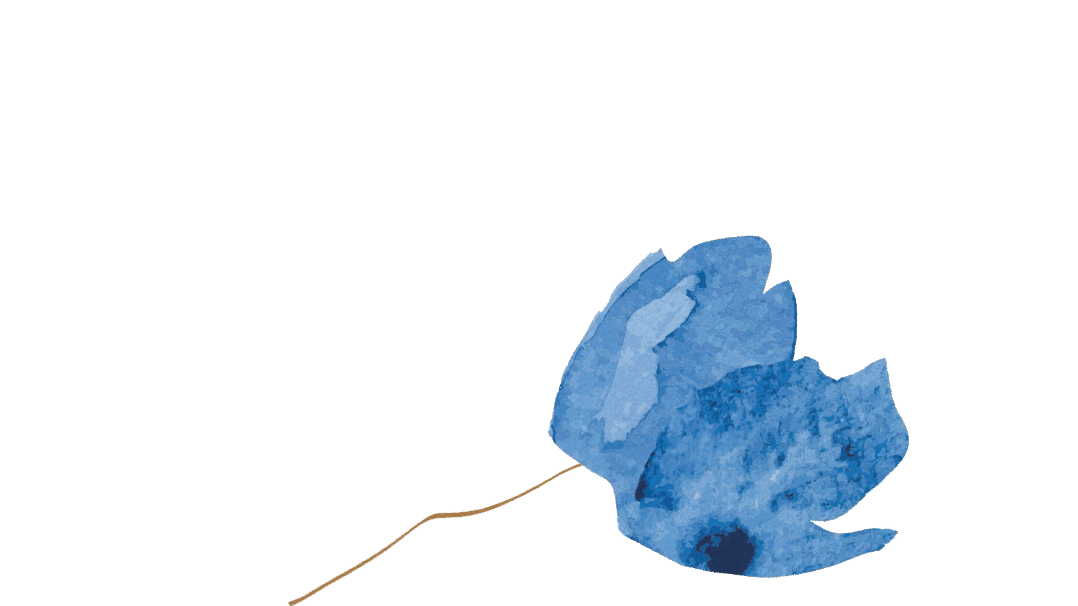
The ability to think and to feel even the most disturbing thoughts and painful emotions brings with it the experience of being alive.

Slide 20
While our journeys to healing vary, each starts with the decision to search, to open the door, and, rather than turn away from the hurt of the past, to walk toward it.

Slide 21
Trauma is transmitted through our minds and through our bodies, and so is resilience and healing.

